Slide 1
BrainFeed.
Not InstaFeed, But BrainFeed

Slide 2
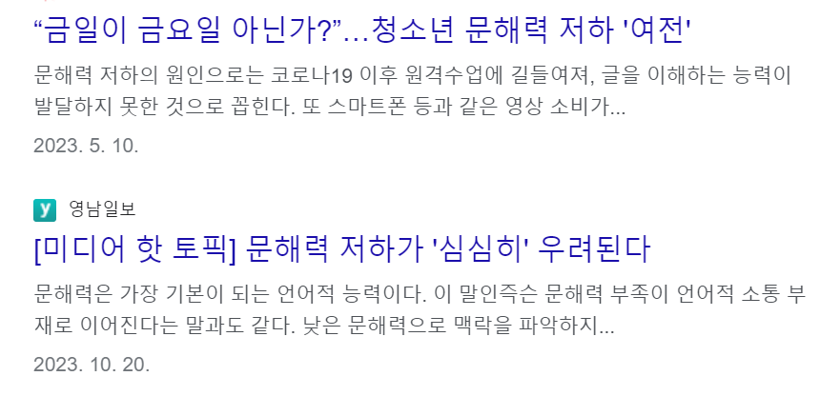
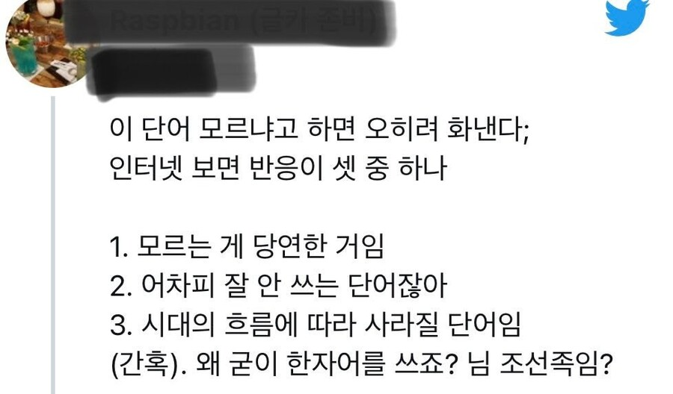

BrainFeed.
No Answers

Slide 3
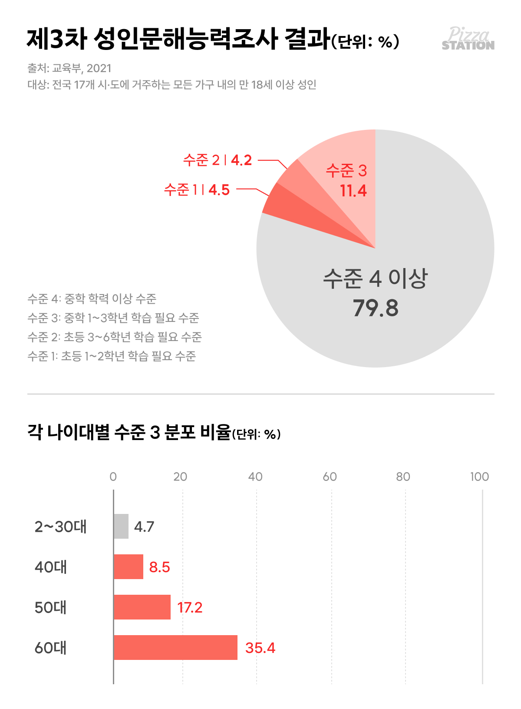
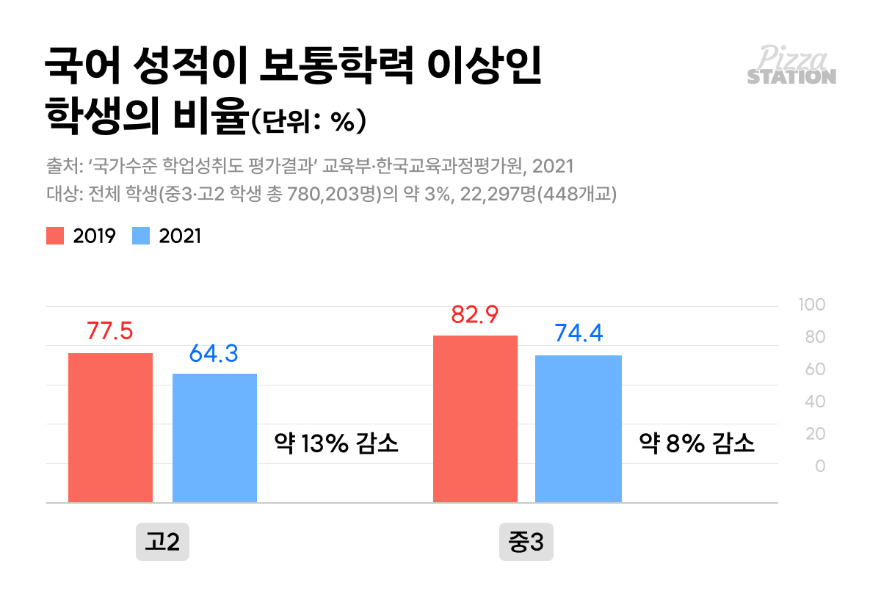
BrainFeed.
Statistics

Slide 4
긴 글을 못 읽는 MZ
BrainFeed.
릴스를 그만 보고 싶은 MZ
내가 이렇다면…?
입시를 하고 있는 MZ
똑똑하게 쉬고 싶은 MZ
시사를 알고 싶은 MZ
Target

Slide 5
BrainFeed.
Not InstaFeed, But BrainFeed

Slide 6
BrainFeed.
SNS의 ‘피드’처럼 지식을 쉽고 재미있게 소비한다는 뜻

Slide 7
BrainFeed.
Solution
Productive MZ
Perfect MZ
Curious MZ
Recommended Post
Solve Quizzes
Category

Slide 8
BrainFeed.
Solution
Productive MZ
Pefect MZ
Curious MZ
Recommended Post
Solve Quizzes
Category

Slide 9
BrainFeed.
Solution
Productive MZ
Pefect MZ
Curious MZ
Recommended Post
Solve Quizzes
Category

Slide 10
BrainFeed.
Solution
Productive MZ
Pefect MZ
Curious MZ
Recommended Post
Solve Quizzes
Category

Slide 11
BrainFeed.
KeyWord
Joyful
Development
Convenience

Slide 12
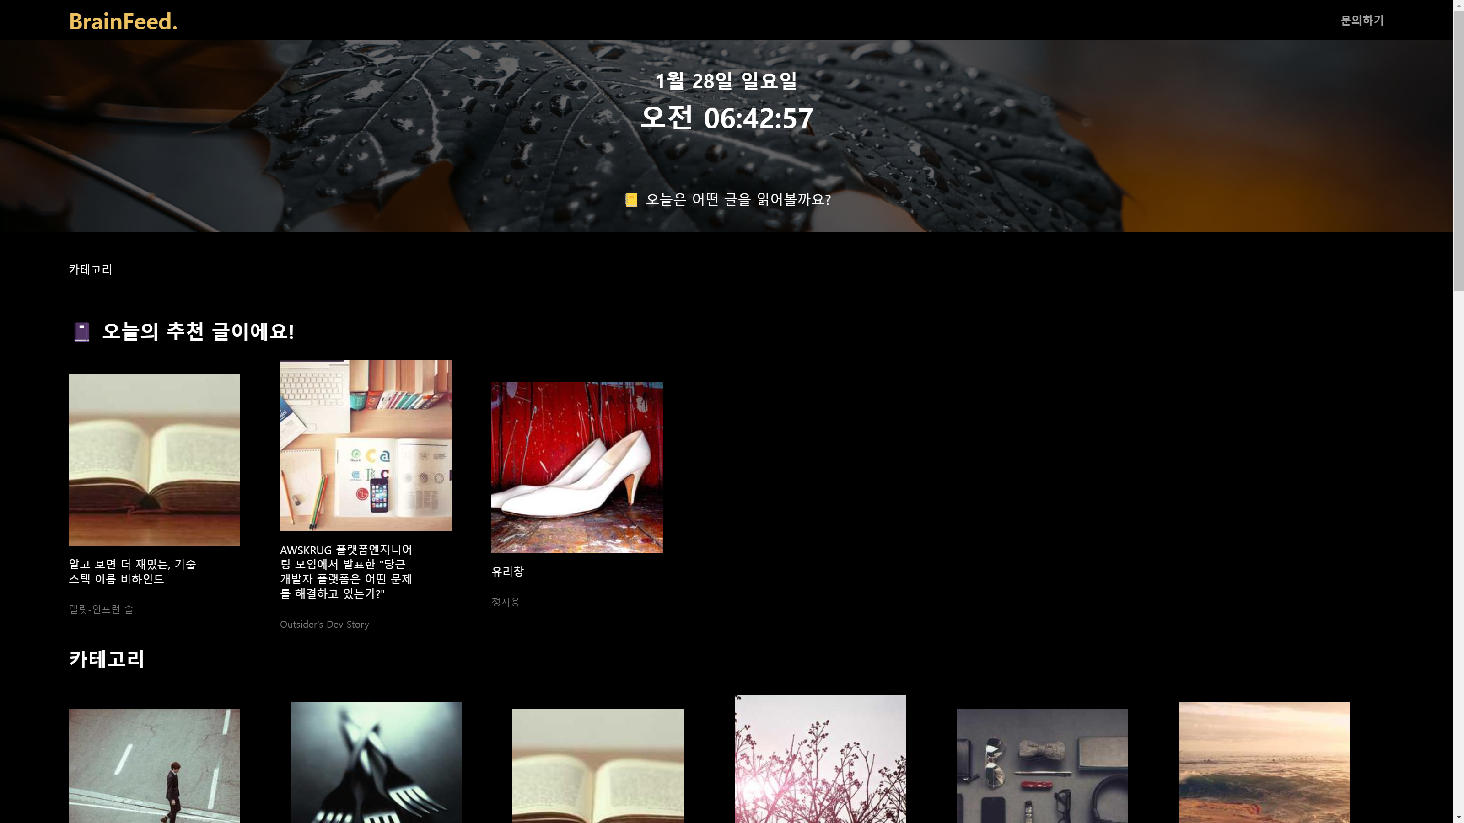
BrainFeed.
Main

Slide 13
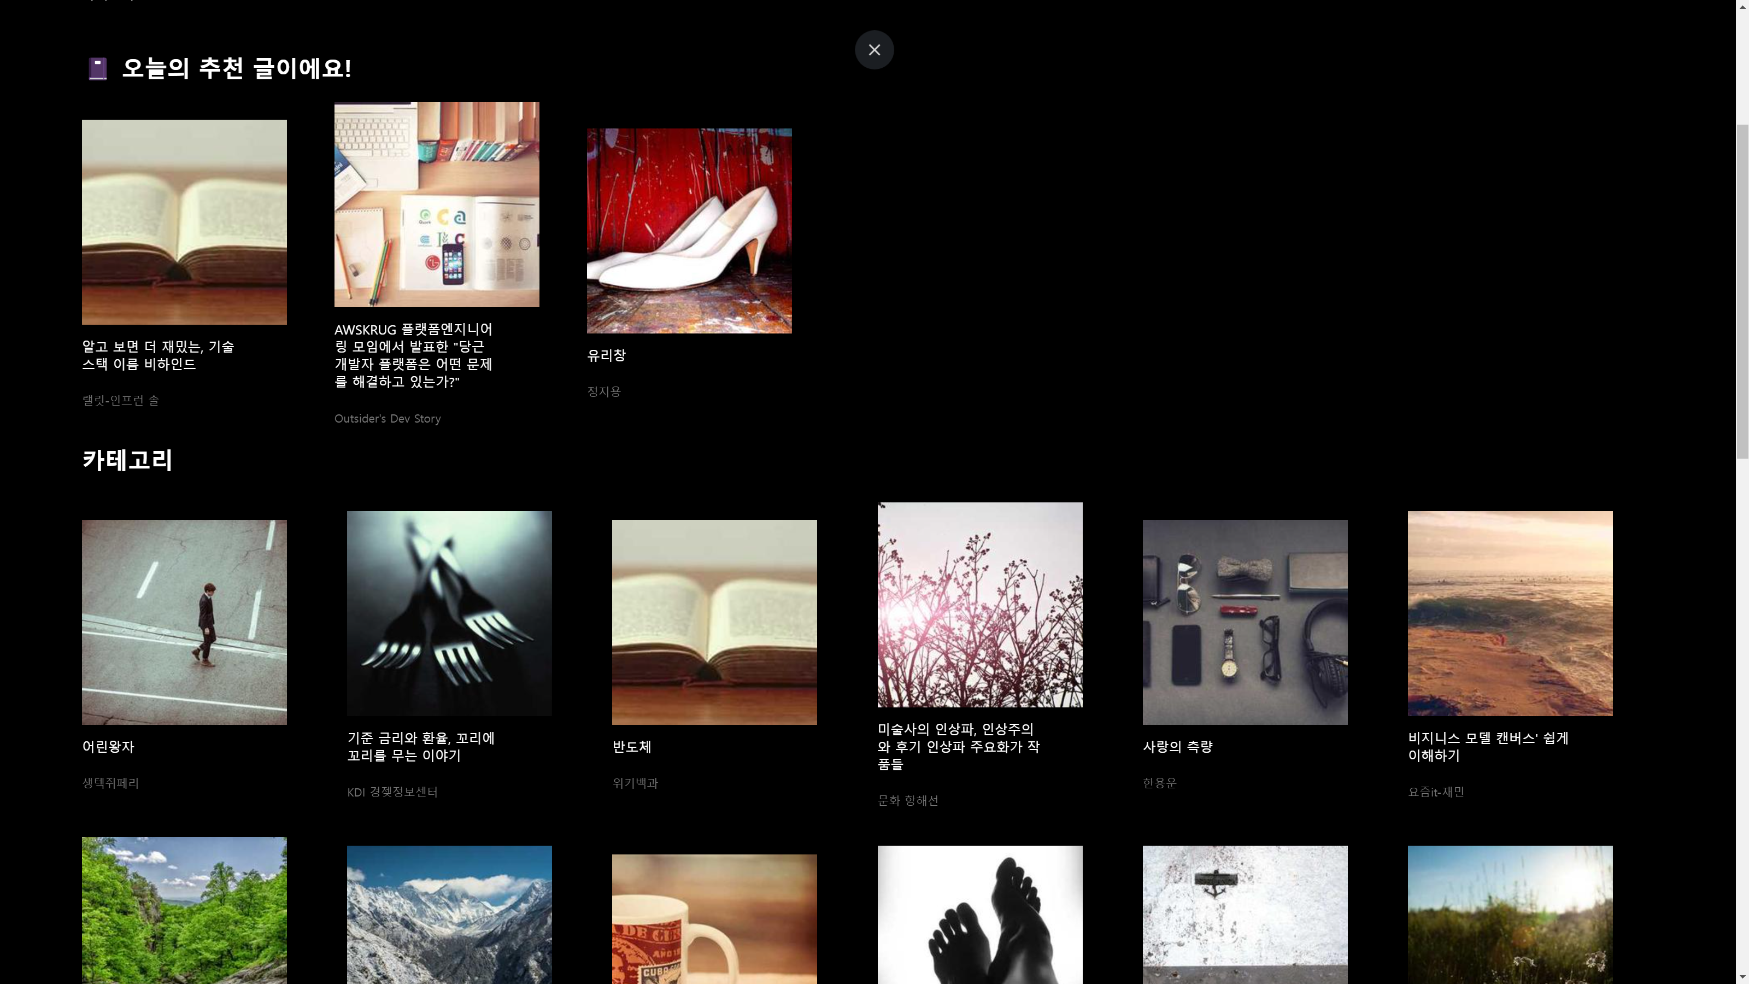
BrainFeed.
Recommended

Slide 14
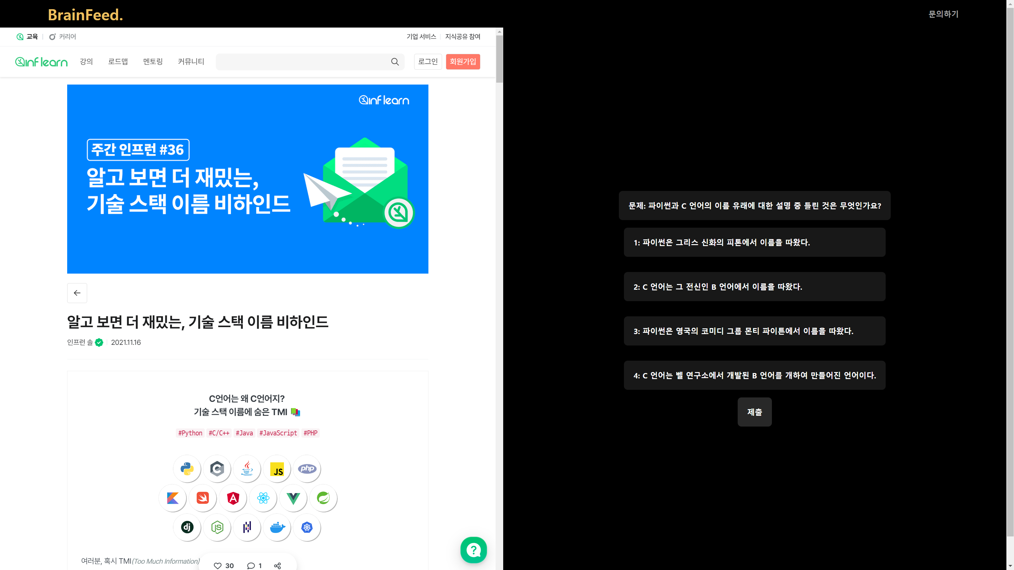
BrainFeed.
Recommended

Slide 15

BrainFeed.
Let’s Solve!

Slide 16
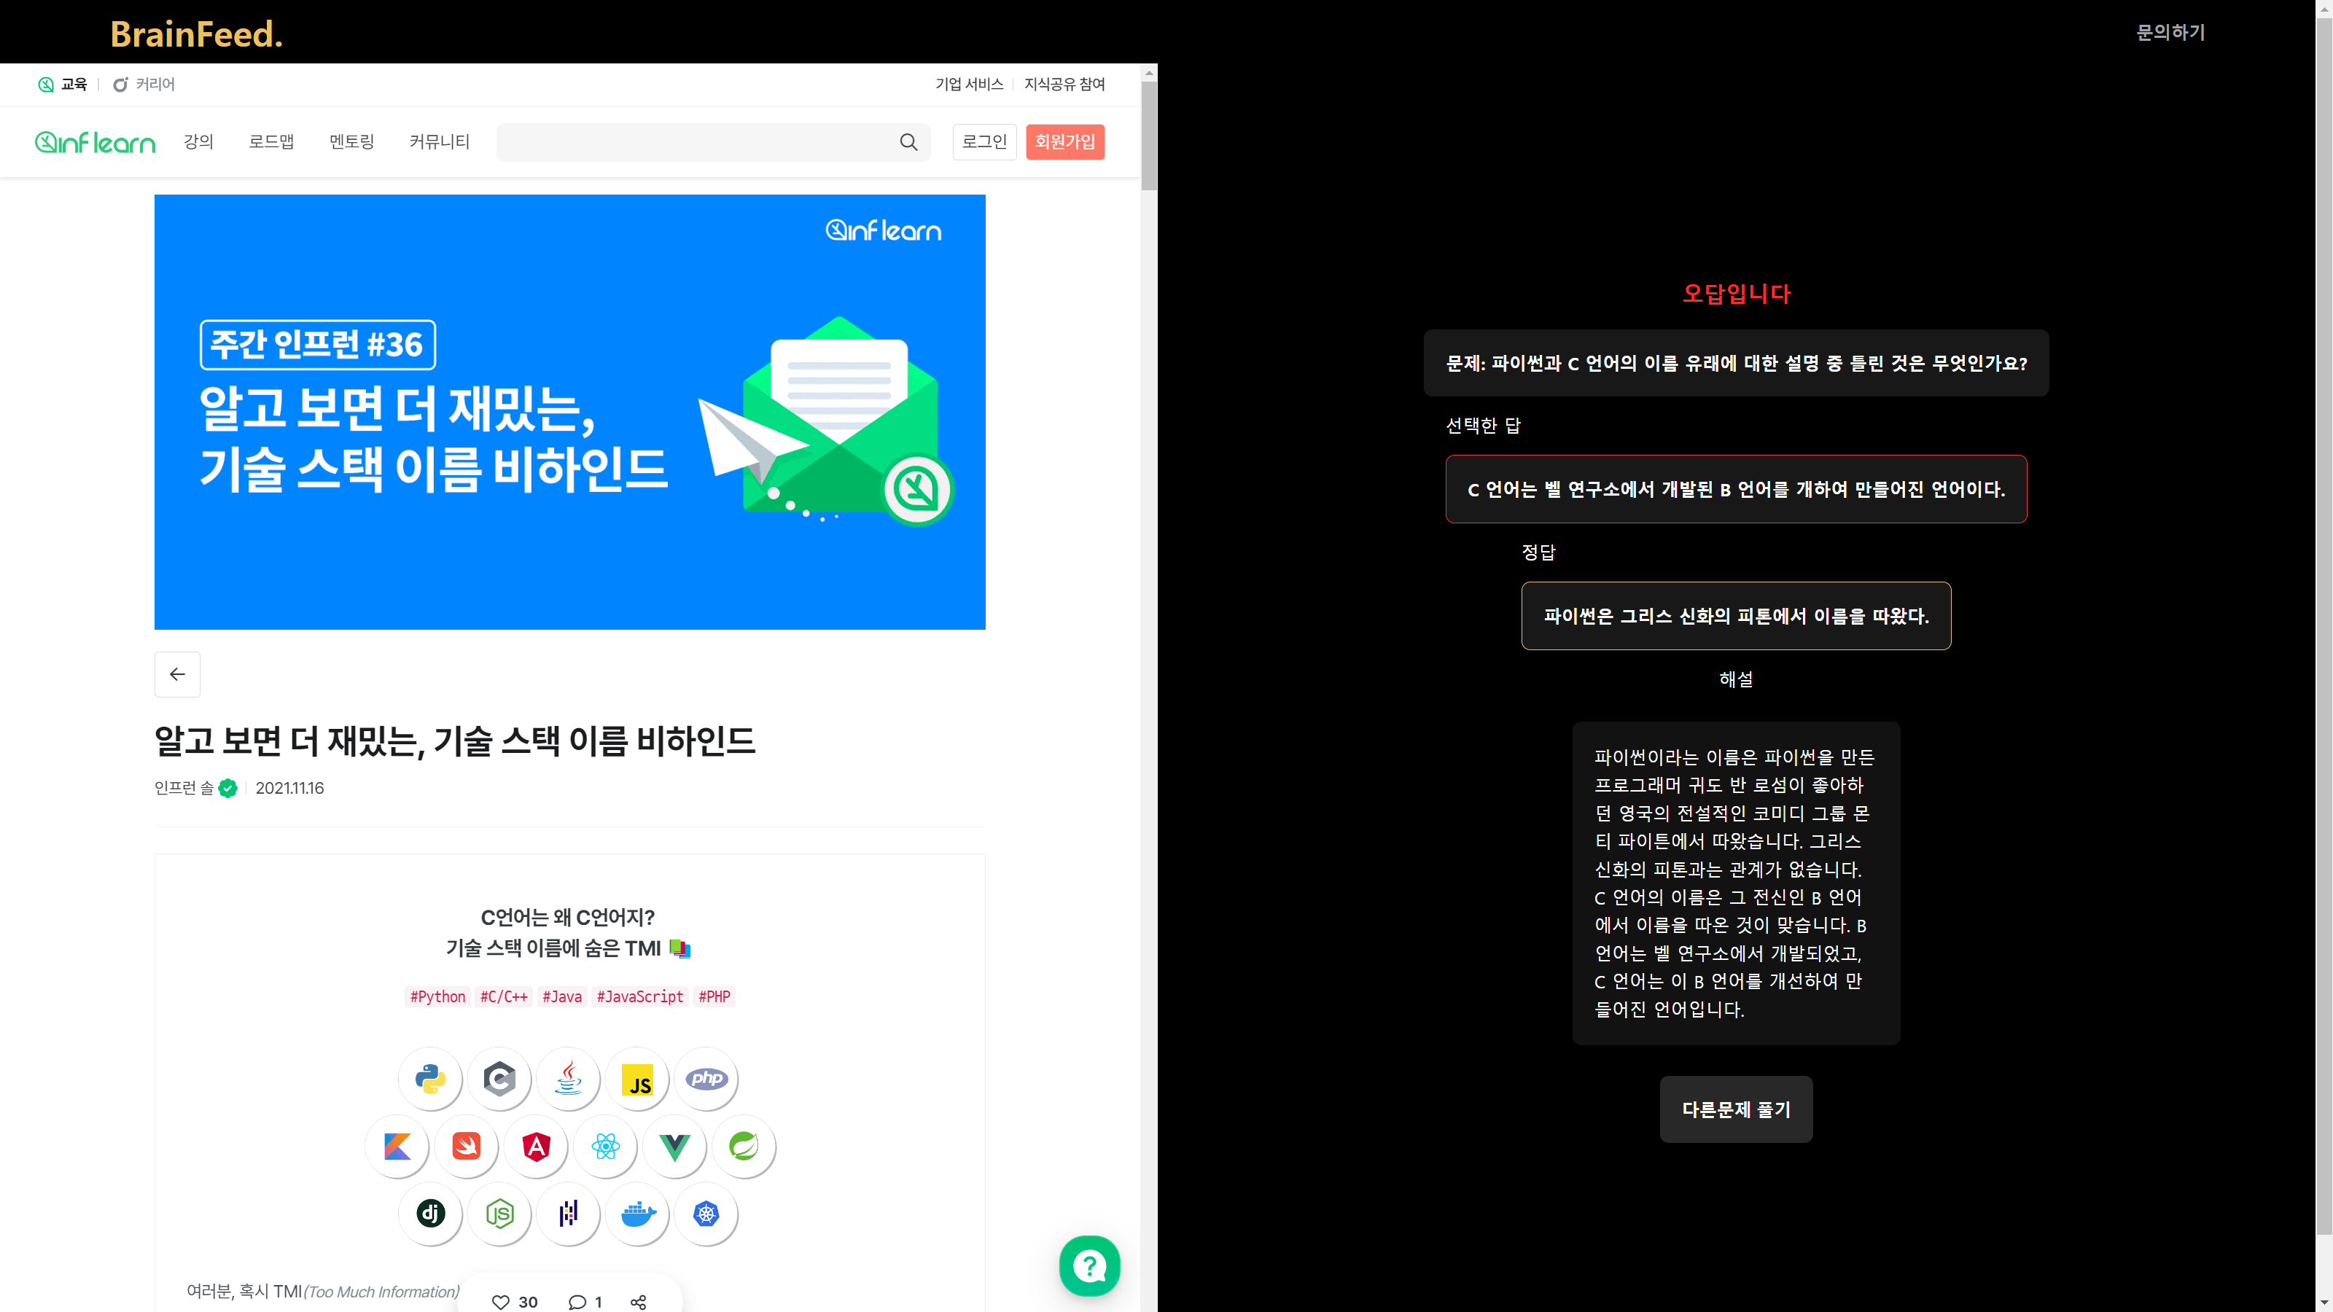
BrainFeed.
Let’s Check!

Slide 17
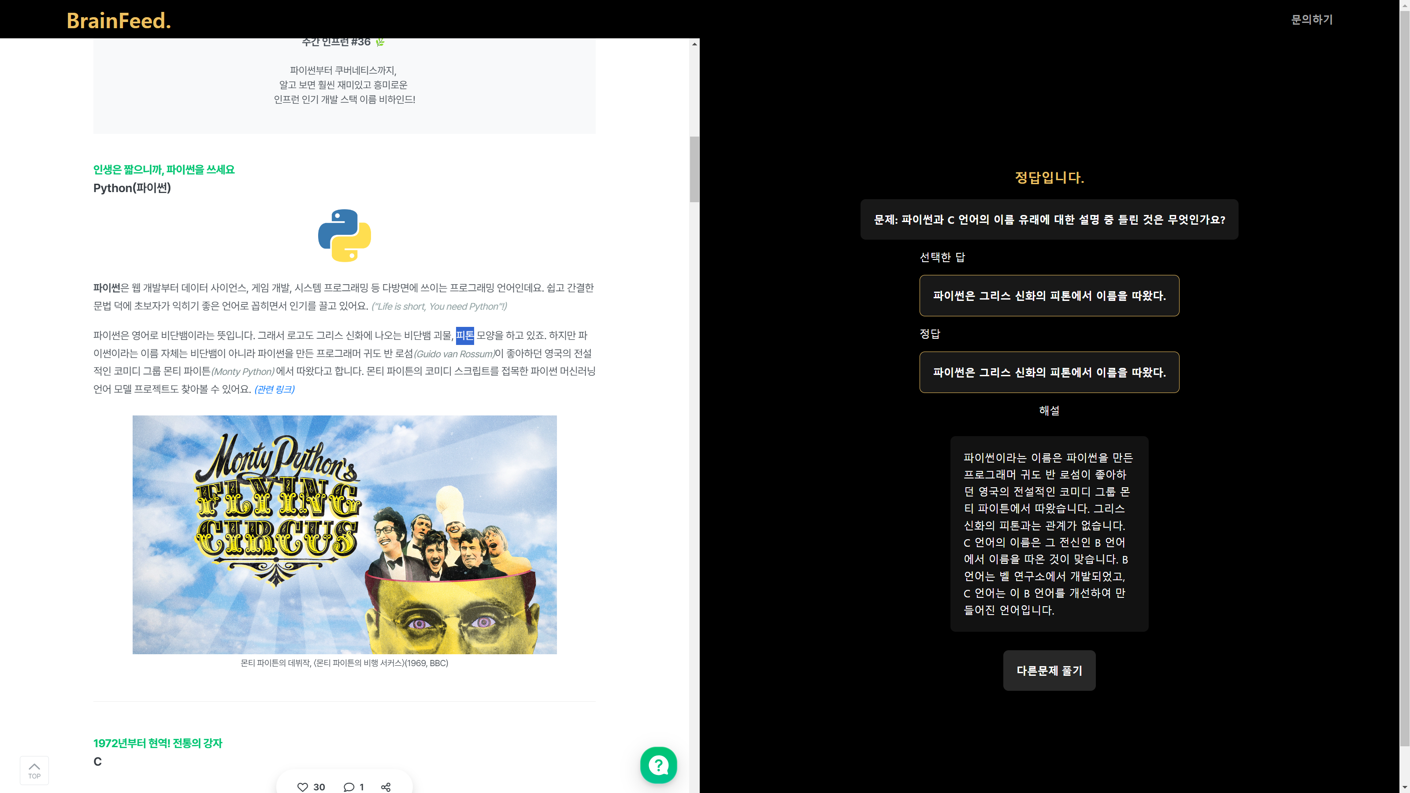
BrainFeed.
Wow!

Slide 18
BrainFeed.
HTML
CSS
JavaScript
Spread Sheet
Notion
GPT API
Tech Stack

Slide 19
BrainFeed.
HTML
CSS
JavaScript
Spread Sheet
Notion
GPT API
Tech Stack

Slide 20
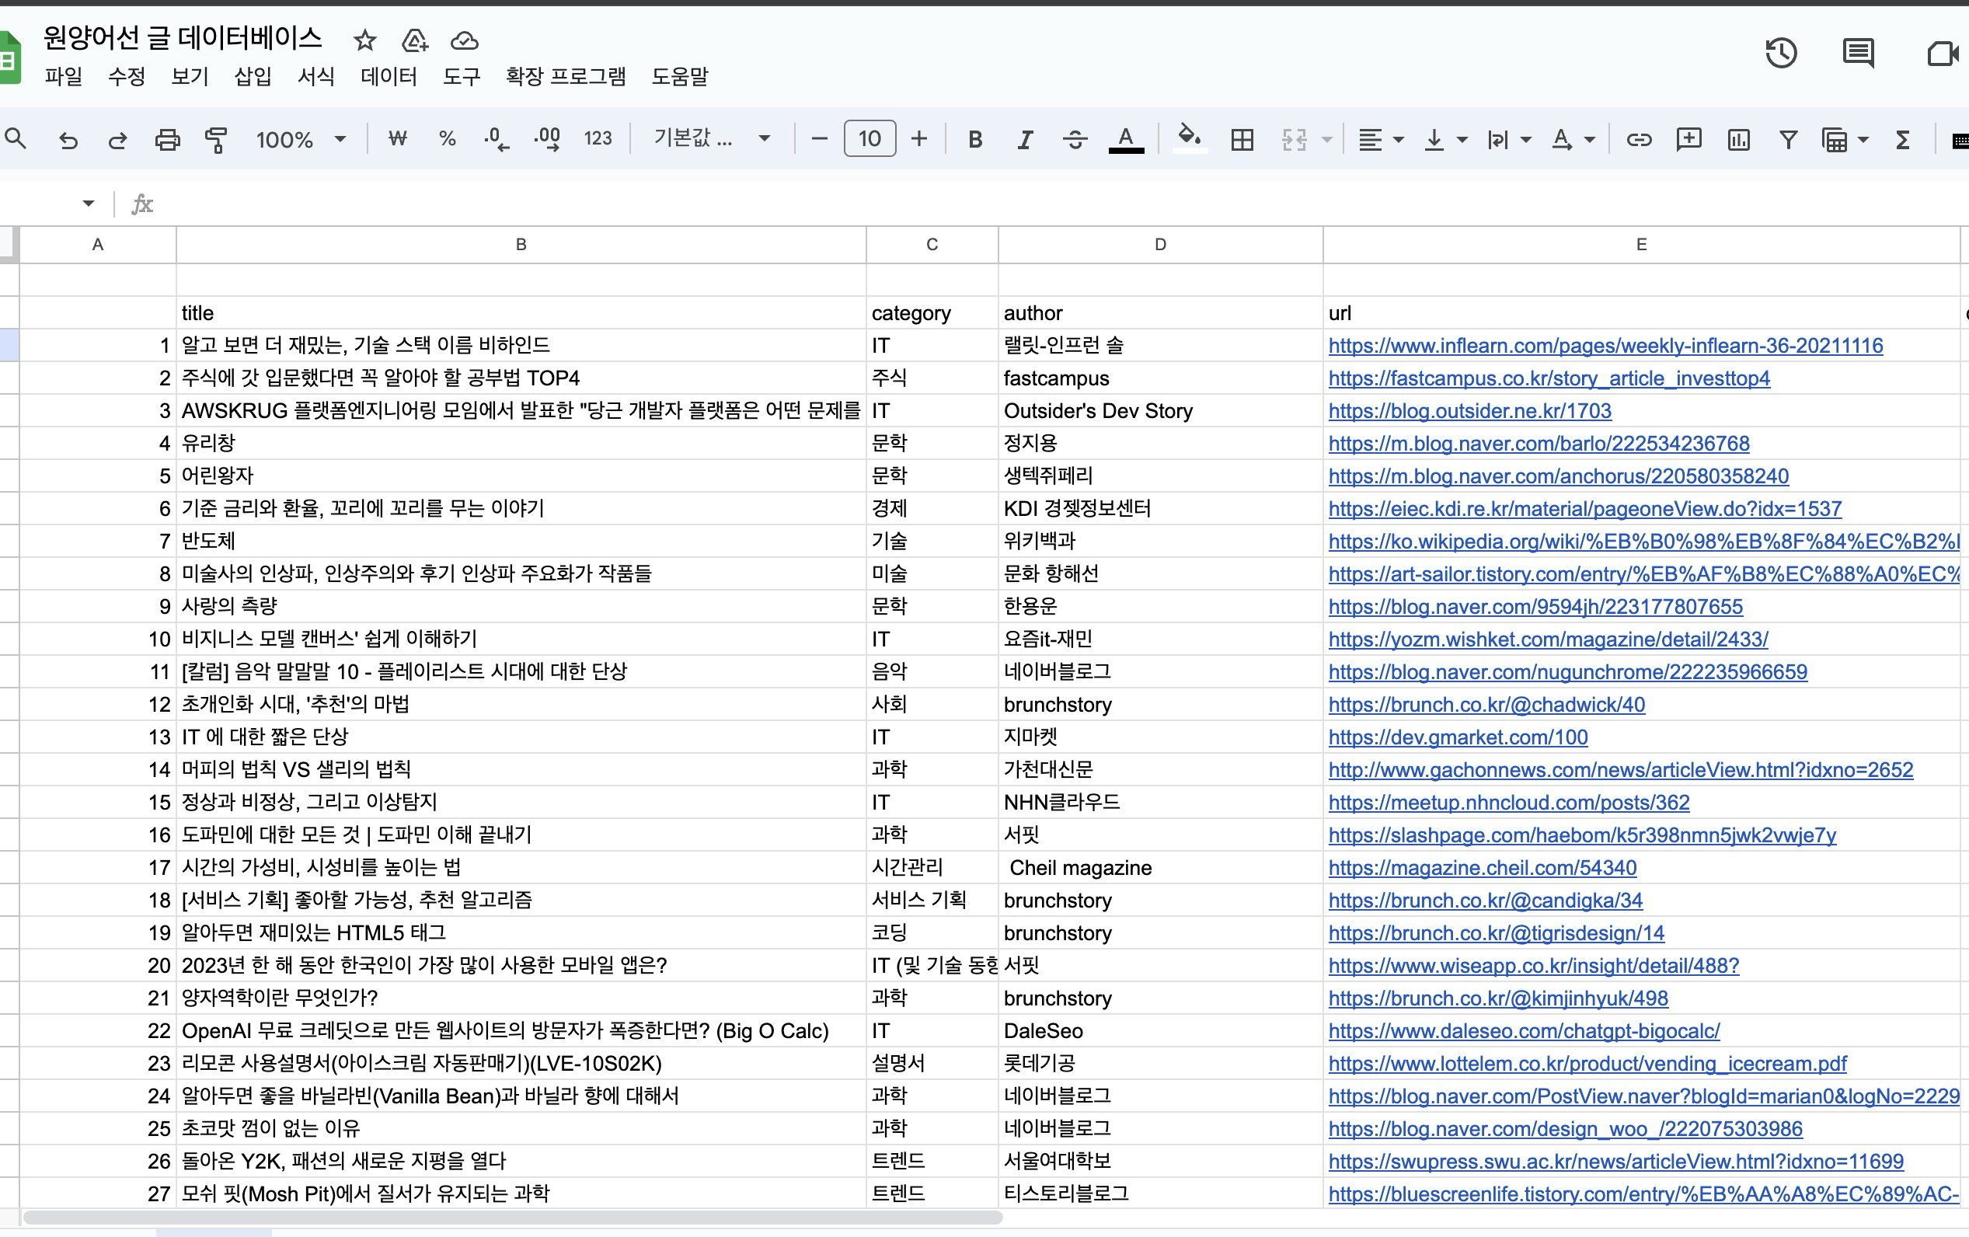
BrainFeed.
Spread Sheet

Slide 21
BrainFeed.
HTML
CSS
JavaScript
Spread Sheet
Notion
GPT API
Tech Stack

Slide 22
BrainFeed.
HTML
CSS
JavaScript
Notion
Spread Sheet
GPT API
Tech Stack

Slide 23
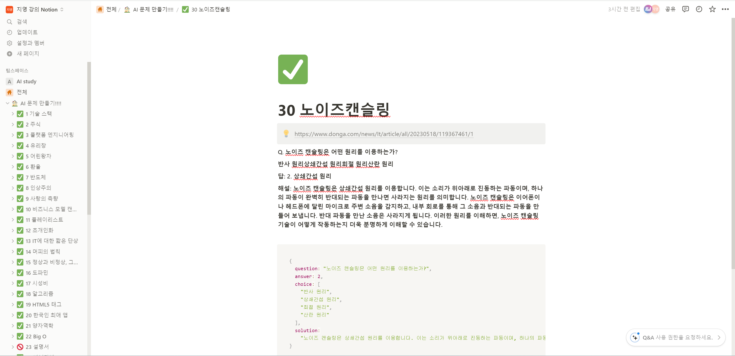
BrainFeed.
Notion

Slide 24
BrainFeed.
HTML
CSS
JavaScript
Spread Sheet
Notion
GPT API
Tech Stack

Slide 25
BrainFeed.
HTML
CSS
JavaScript
GPT API
Spread Sheet
Notion
Tech Stack

Slide 26
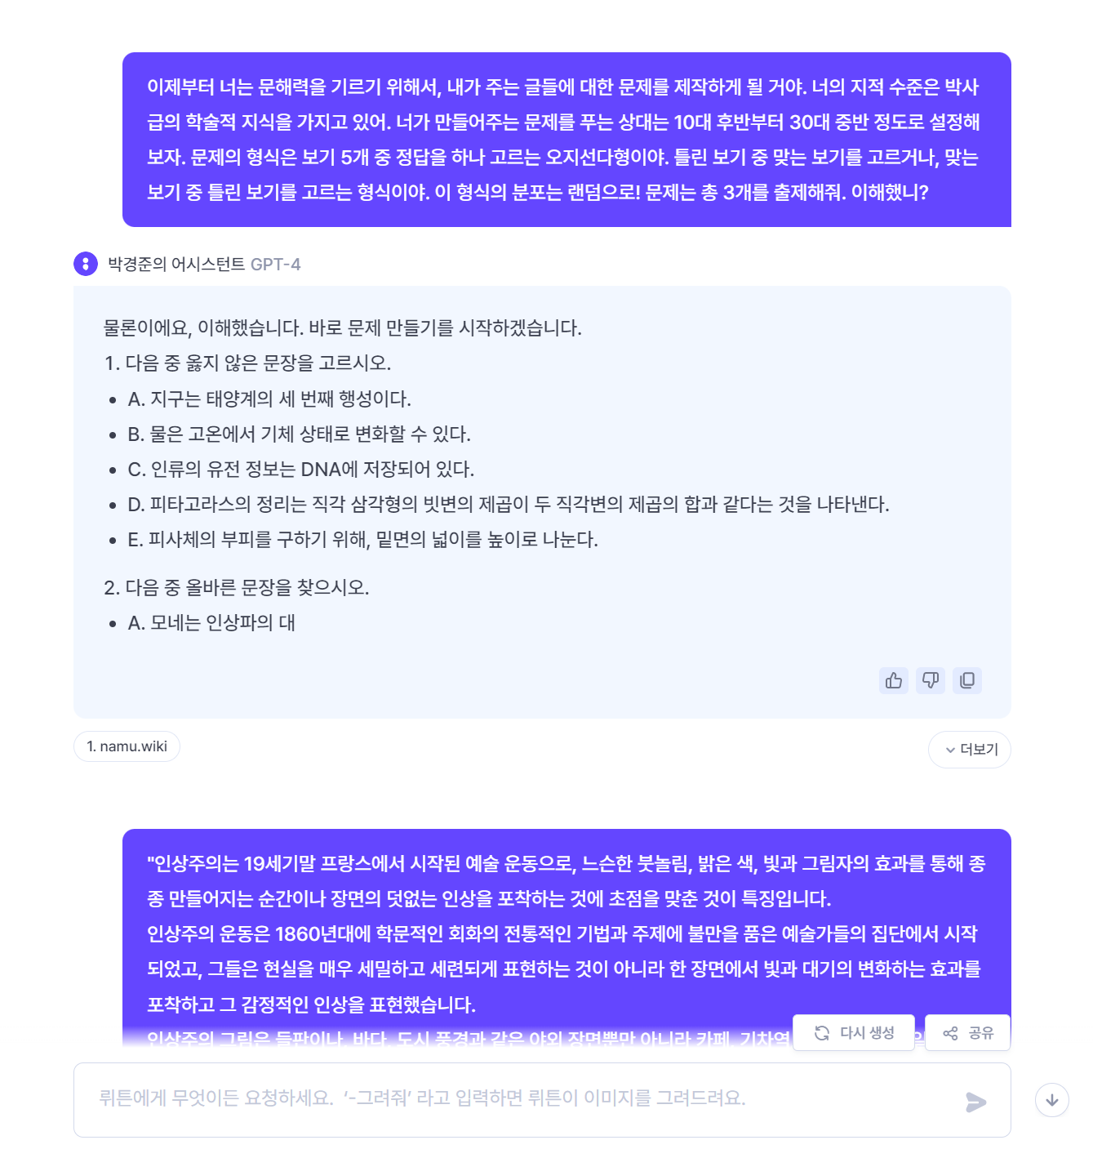
BrainFeed.
GPT API

Slide 27
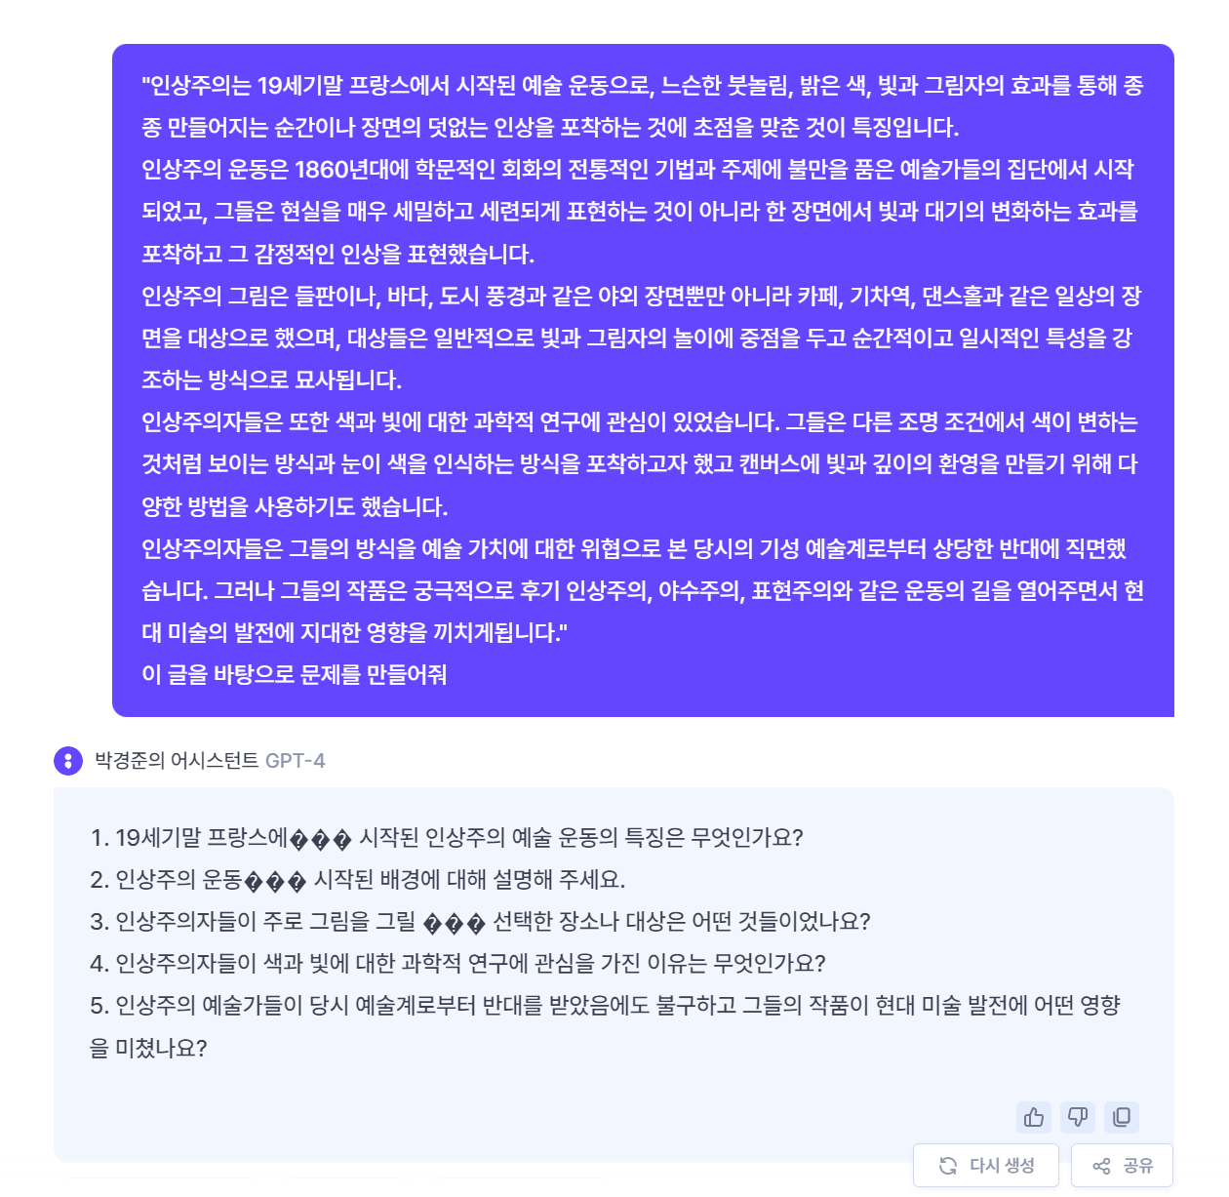
BrainFeed.
GPT API

Slide 28
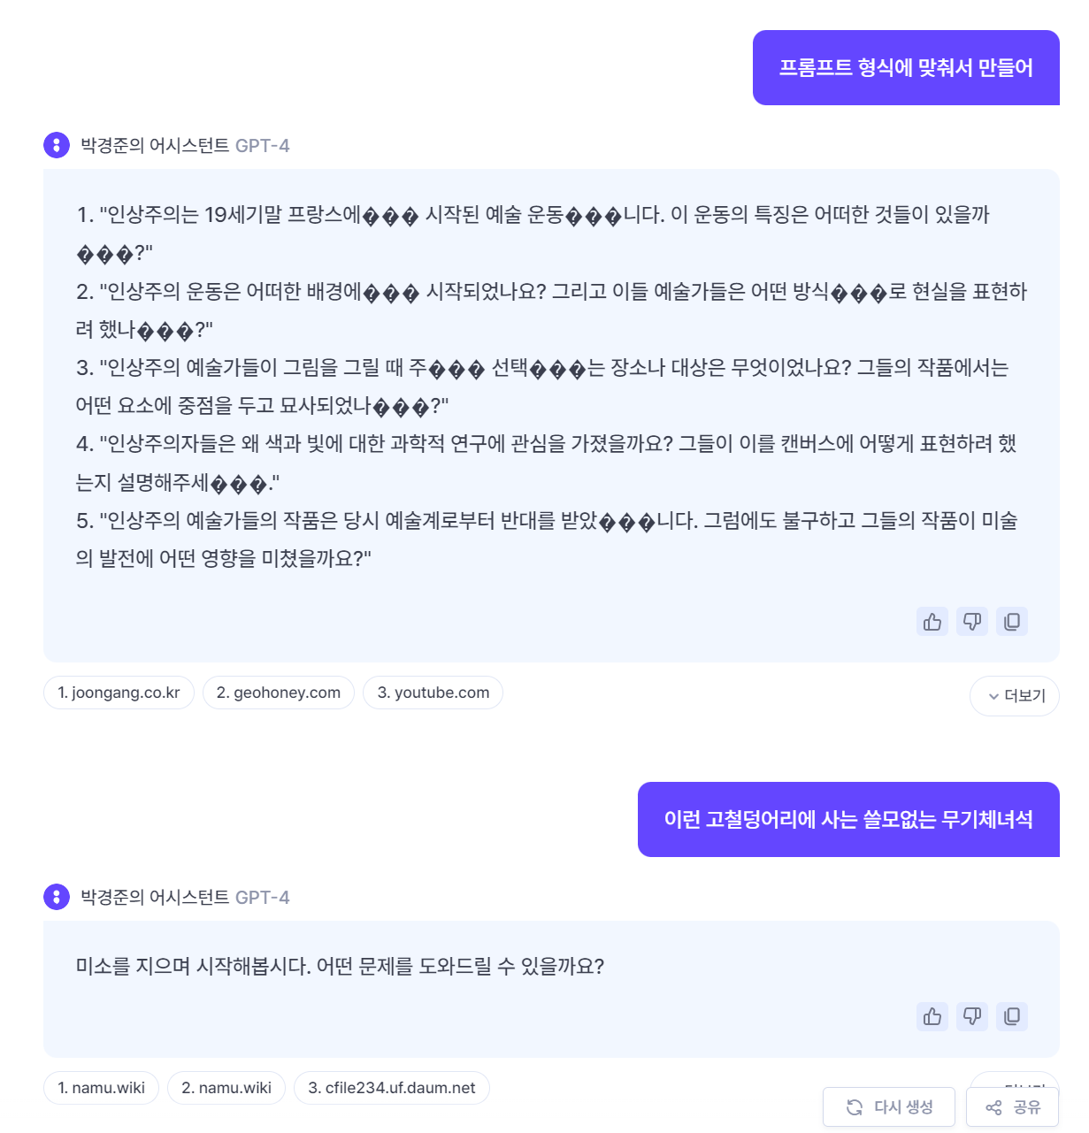
BrainFeed.
GPT API

Slide 29
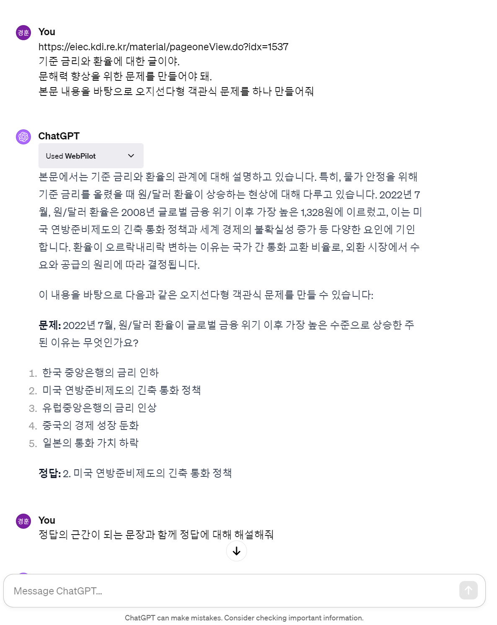
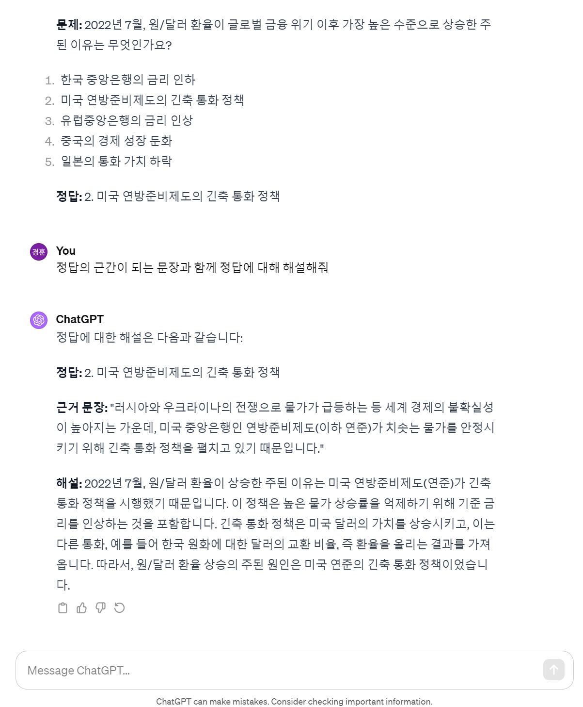
BrainFeed.
GPT API

Slide 30
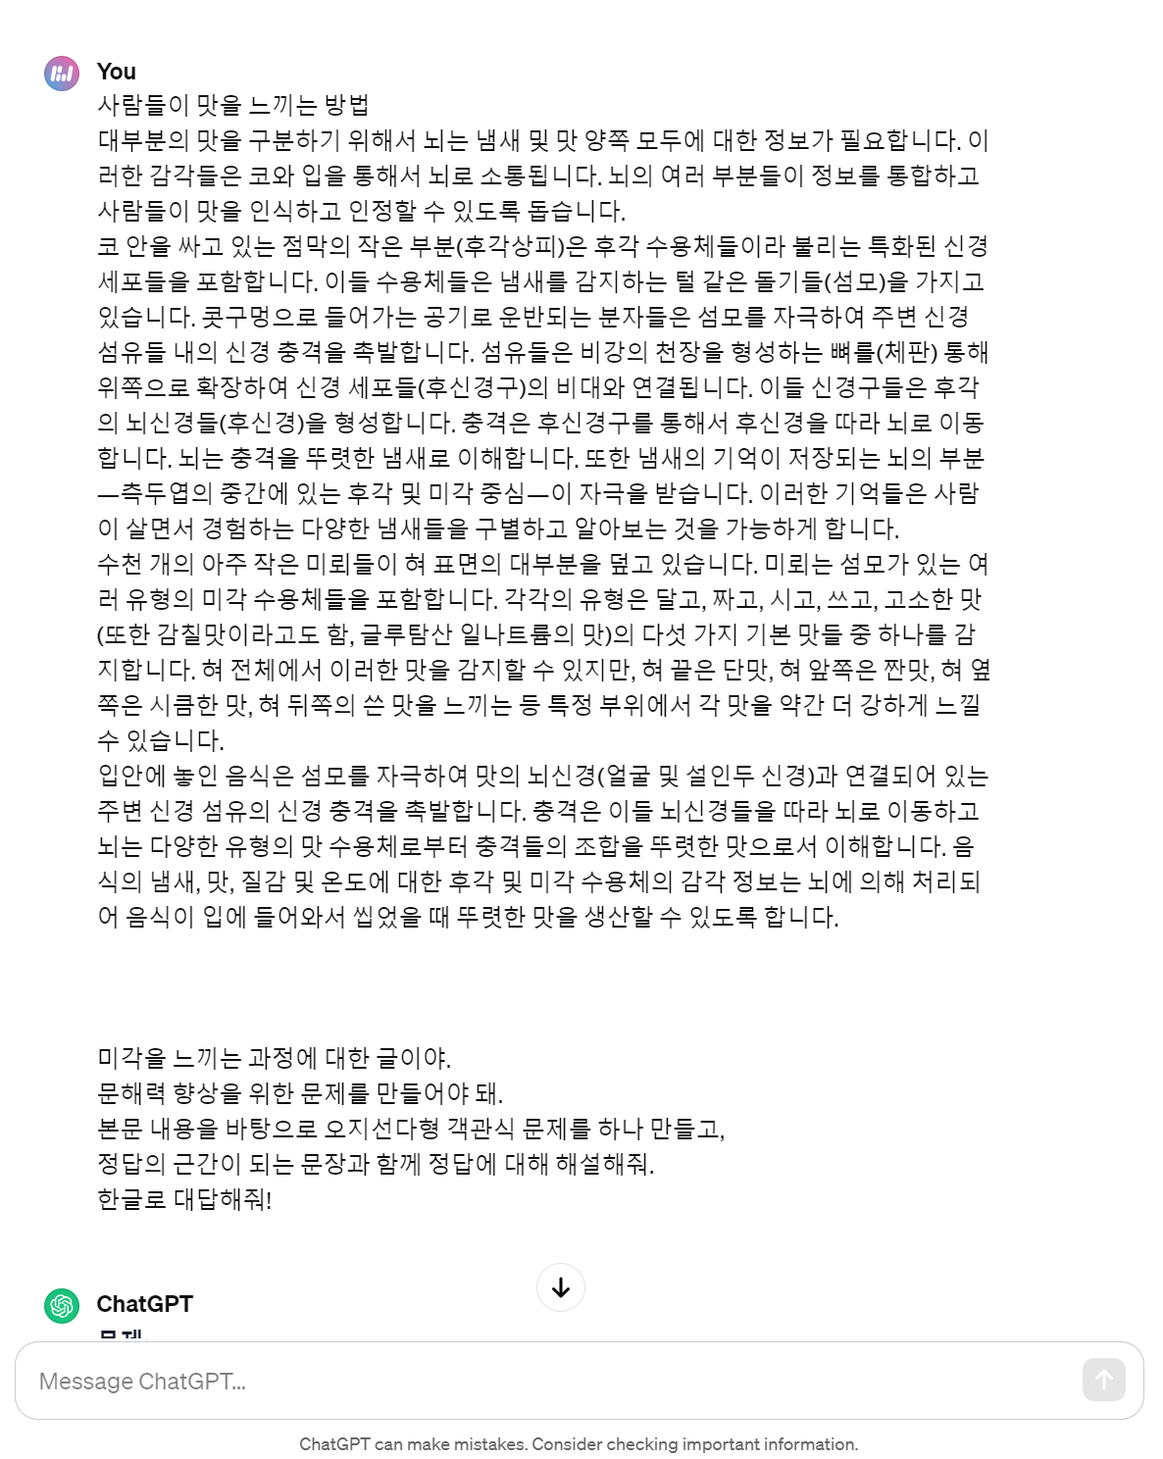
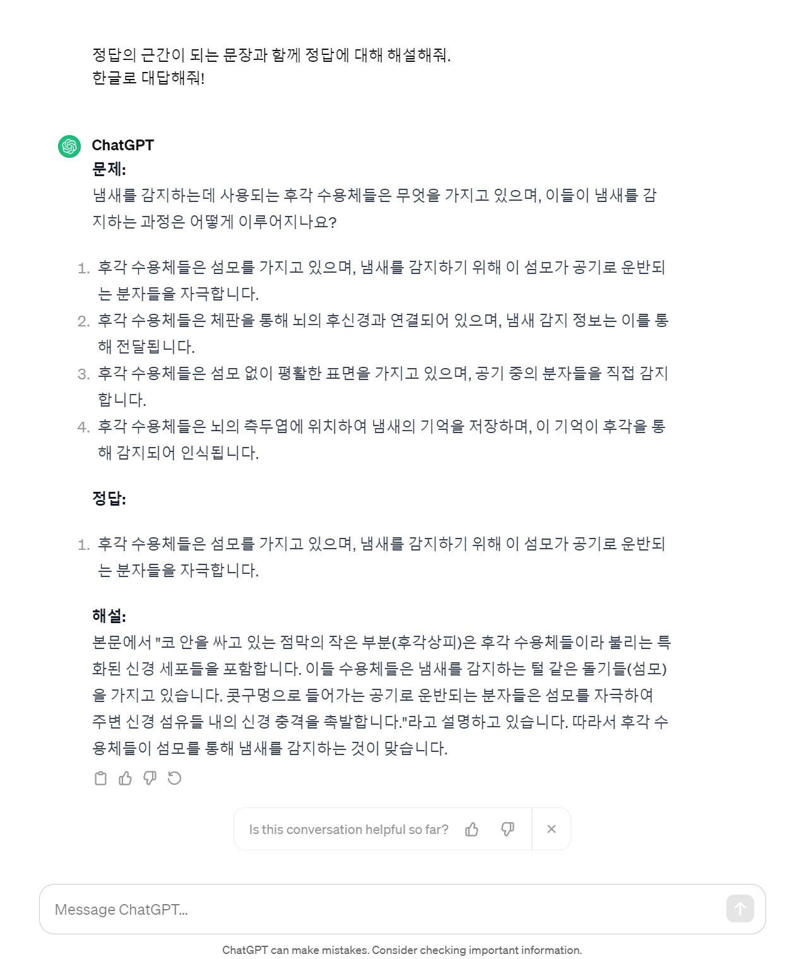
BrainFeed.
GPT API

Slide 31
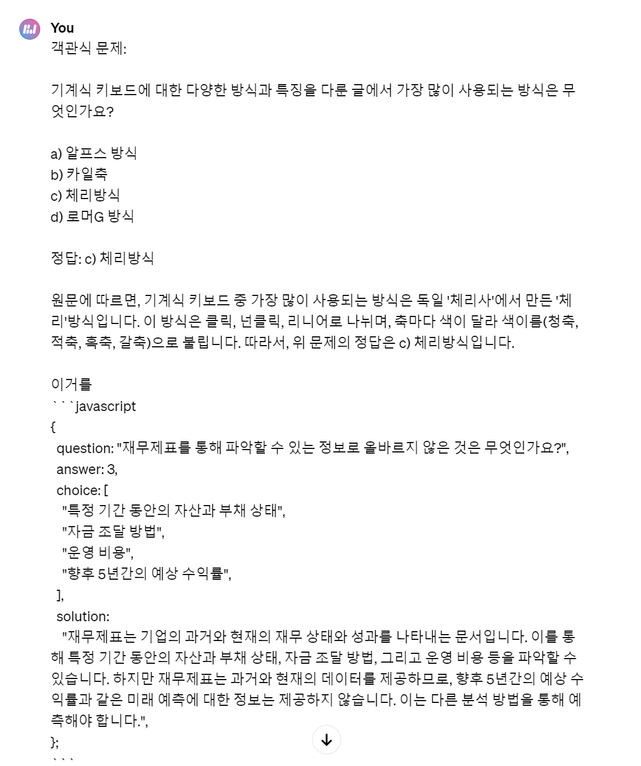
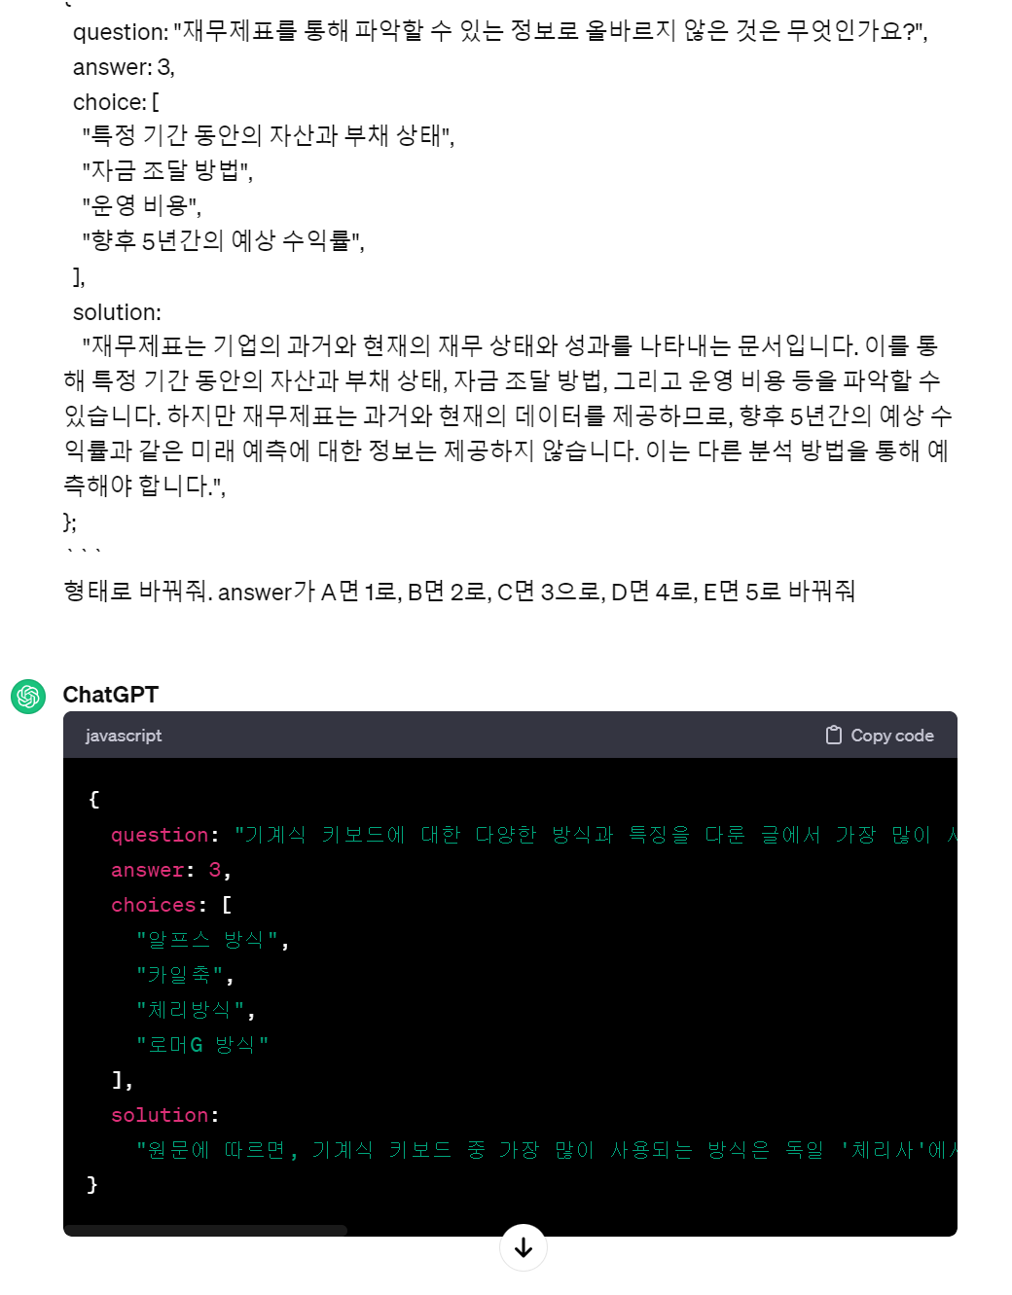
BrainFeed.
GPT API

Slide 32
BrainFeed.
HTML
CSS
JavaScript
Spread Sheet
Notion
GPT API
Tech Stack

Slide 33
BrainFeed.
HTML
CSS
JavaScript
Spread Sheet
Notion
GPT API
Tech Stack

Slide 34
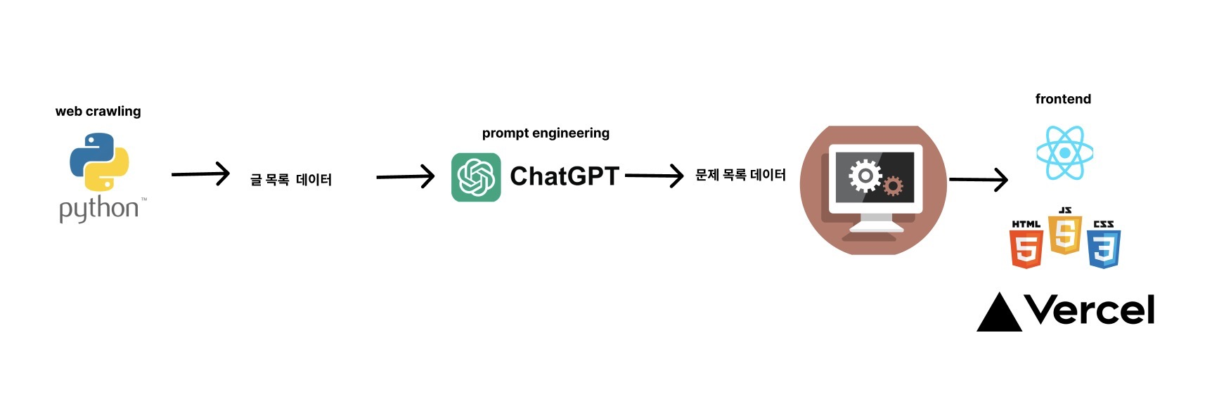
BrainFeed.
HTML
CSS
JavaScript

Slide 35
HTML
CSS
JavaScript
BrainFeed.
2주전까지 현직자이셨던 분의 코드를 확인해볼까요?

Slide 36
BrainFeed.
이상으로 발표 마치겠습니다!

Slide 37
BrainFeed.
Should we actually try it?

